Slide 1
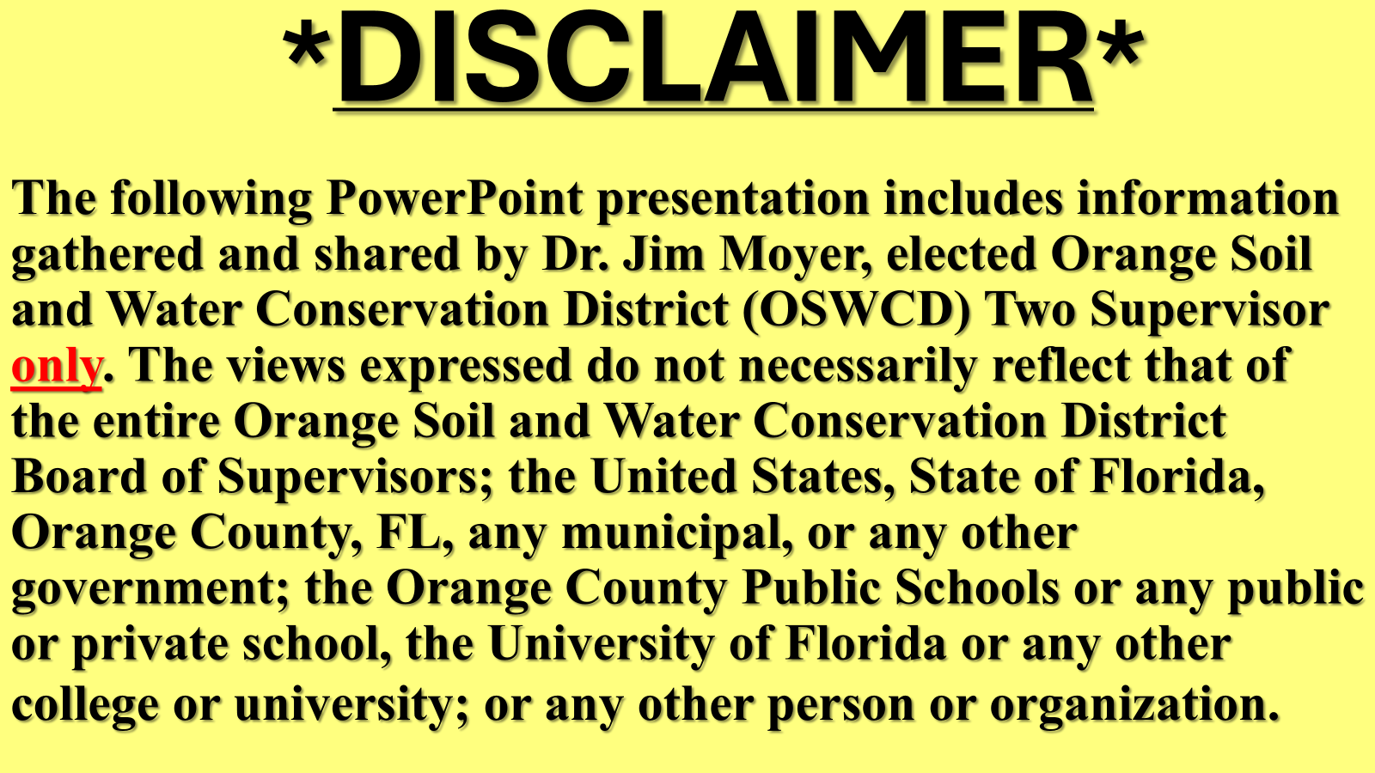
2026-05-19 Public Comment Exhibit 2 – Orange County Soil and Water Conservation District 2 Supervisor Jim Moyer

Slide 2


Slide 3
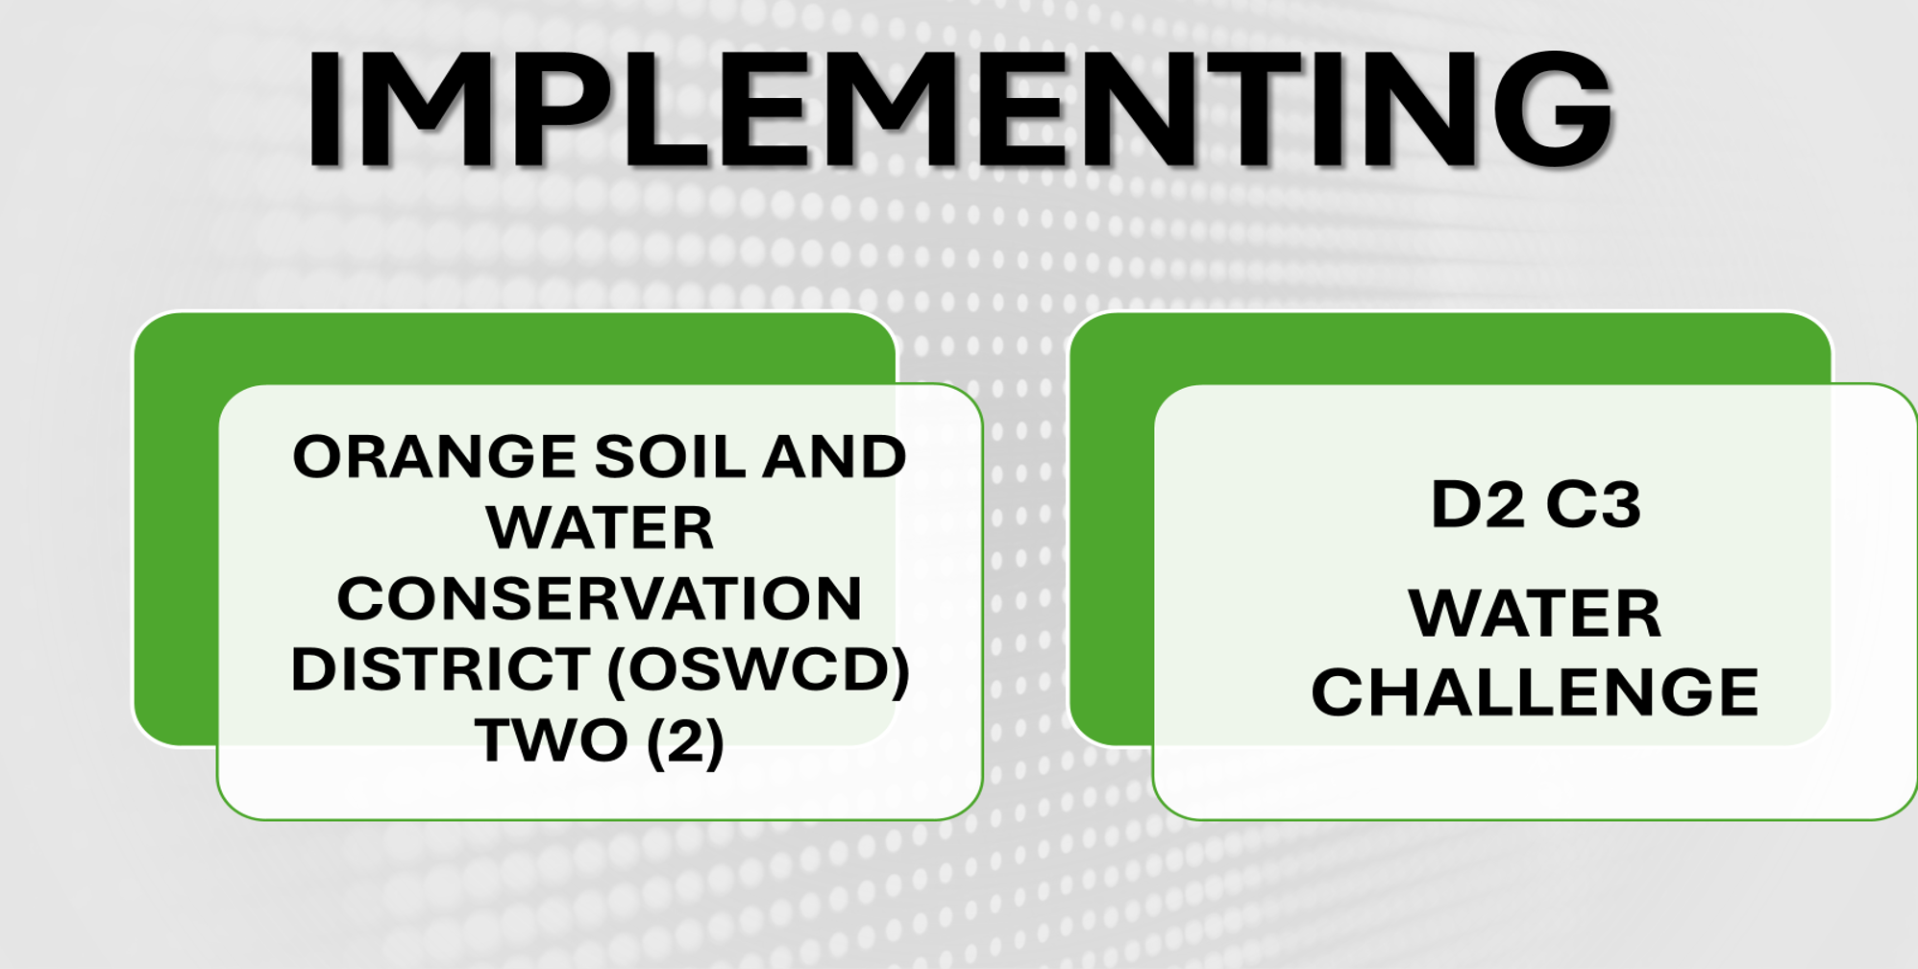
LET US KNOW HOW YOU ARE DOING!
OSWCD.D2C3WATERCHALLENGE@GMAIL.COM

Slide 4
REMINDER
OSWCD
D2 C3
WATER CHALLENGE
CHANGE create two new habits
CONSERVE one new daily water conservation habit
CLEAN one new daily water improvement habit

Slide 5
WHY PARTICIPATE?
*United States uses about TWICE the global per person average, AND
*About same as China and India with roughly FOUR times more people
*Florida’s outdoor residential water use now exceeds agriculture water use
*Despite Orange County’s conservation initiatives, per person per day water usage is over twice that of the global average due almost entirely to outdoor home irrigation

Slide 6

D2 C3
WATER CHALLENGE
Change
How do I
waste water?
2. How do I pollute our water bodies?

Slide 7
D2 C3
WATER CHALLENGE
(CHANGE BEGINS WITH YOU!)
Conserving - Pick Any One
WATERUSEITWISELY.COM
HTTPS://WATERUSEITWISELY.COM/100-WAYS-TO-CONSERVE-WATER/
LISTS OVER 100 WAYS TO SAVE WATER BUT JUST BEGIN WITH ONE THAT YOU KNOW THAT YOU CAN AND WILL CONTINUE TO DO FOR THE REST OF YOUR LIFE!!
*INVOLVE FAMILY, FRIENDS, NEIGHBORS, CO-WORKERS IN WATER CONSERVATION*

Slide 8
D2 C3
WATER CHALLENGE
(CHANGE BEGINS WITH YOU!)
Clean - Pick Any One
GreenCoast.org
Reduce Water Pollution
LISTS 16 WAYS TO REDUCE WATER POLLUTION JUST BEGIN WITH ONE THAT YOU KNOW YOU CAN AND WILL CONTINUE TO DO FOR THE REST OF YOUR LIFE!!
*INVOLVE FAMILY, FRIENDS, AND EVERYONE IN PREVENTING WATER POLLUTION*

Slide 9


BE SMART, DO YOUR PART

Slide 10


