Slide 1
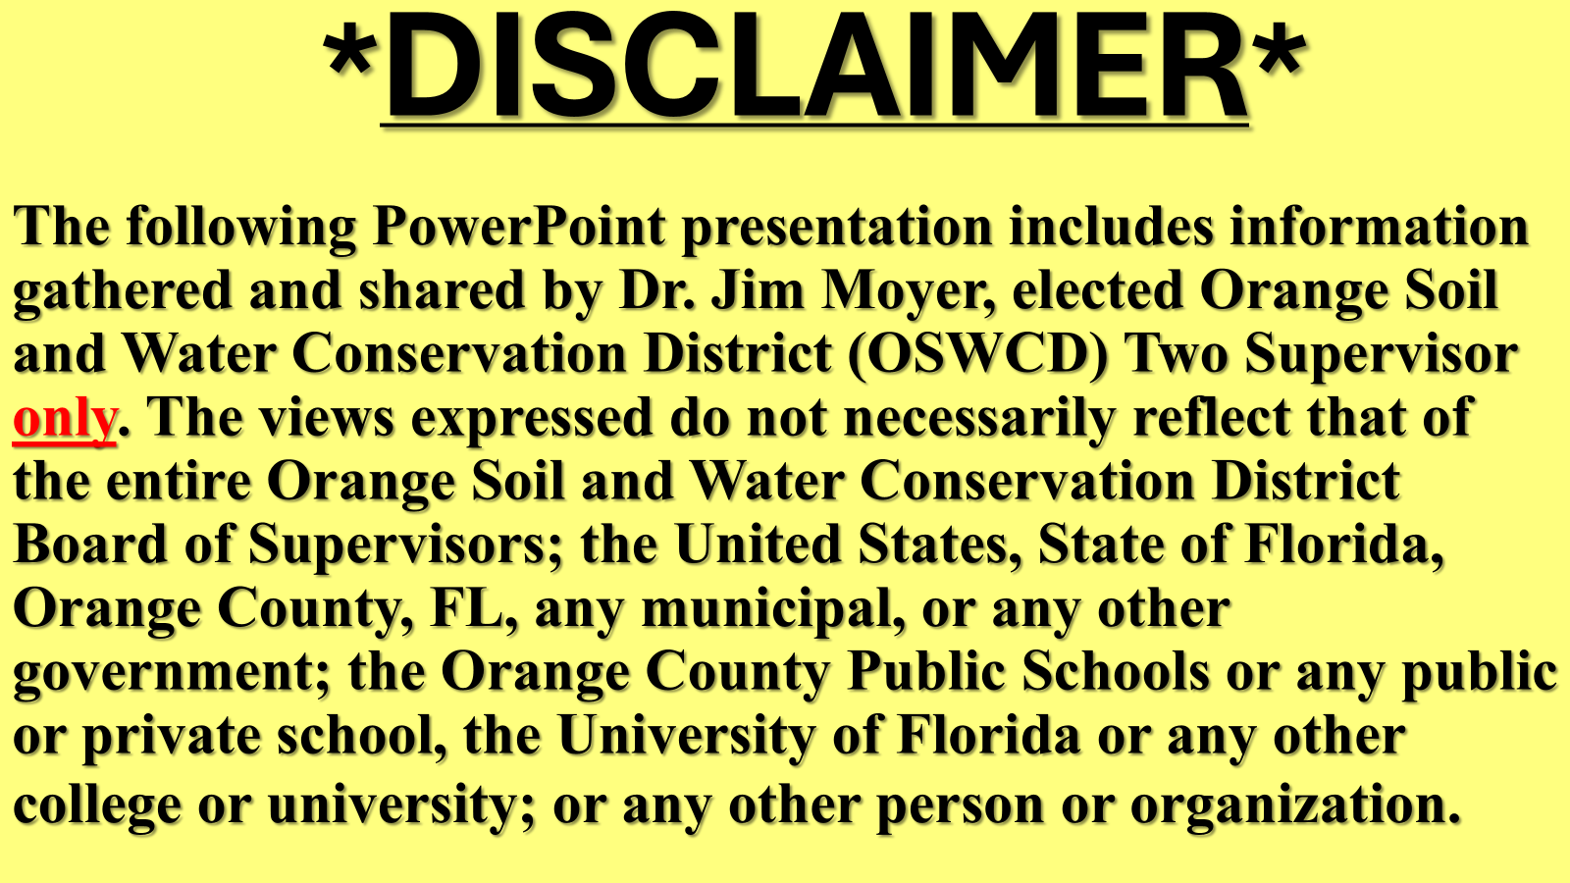
2026-06-16 Public Comment Exhibit 3 – Orange County Soil and Water Conservation District 2 Supervisor Jim Moyer

Slide 2
YES, IMPORTANT TOPIC!
THANK YOU
MR. LEROY BELL
APOPKA

Slide 3
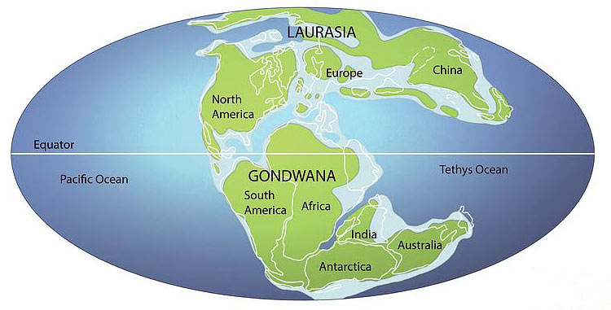
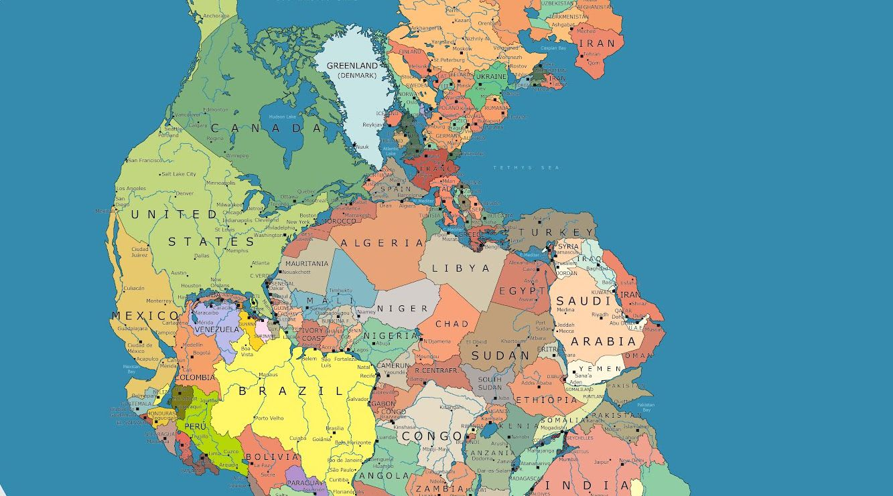
FLORIDA
NOT NORTH AMERICA
500M-300M
PART PANGEA – ONE MASS
300M-200M

Slide 4
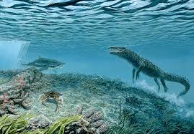
FL: UNDERWATER
200M TO 30M

Slide 5
FLORIDA AQUIFER
Major changes in land and water took place for nearly 500M years forming today’s Florida Aquifer:
*Drifting of foundational bedrock (plate)
*Limestone formed while underwater
*Sand, clay coming from northeast U.S.
*Sea level rise, fall changed size
*Acidic groundwater NW/SE broke limestone

Slide 6
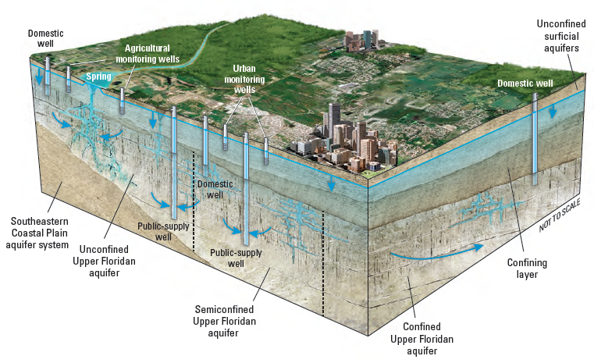
RESULT = FLORIDA AQUIFERS

Slide 7
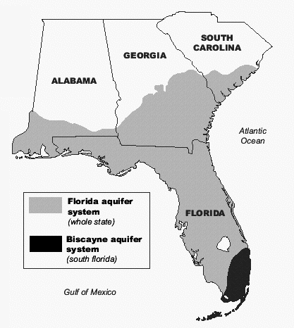
WATER SOURCE - FL, PARTS SE

Slide 8
WHY THIS MATTERS!
*The Florida Aquifer now Supplies Water For 90% of Florida Residents, and
*Nearly 100% of Orange County Residents*
*alternative sources being put in place

Slide 9
FLORIDA AQUIFER
*WET SEASON – LATE MAY TO MID-OCTOBER: WE HOPE REPLENISHES
*DRY SEASON – MID-OCTOBER TO LATE MAY: WHEN PARTS OF FLORIDA AQUIFER MAY DECREASE BELOW 20TH PERCENTILE CAUSING RESTRICTED WATER USE

Slide 10
Western Orange County differs from the rest of our county
Florida aquifer water supplies for West Orange County has near-surface replenishment thus:
*Higher risk of pollutants and runoff
*Area, historically, more agriculture and septic
Result: the Florida aquifer here has higher degree of vulnerability to surface pollution (need Clean)

Slide 11
MAKE A DIFFERENCE
OSWCD D2 C3 ALL YEAR
Change HABITS
Conserve WATER use
Clean WATER BODIES

Slide 12


BE SMART, DO YOUR PART

Slide 13


