Slide 1
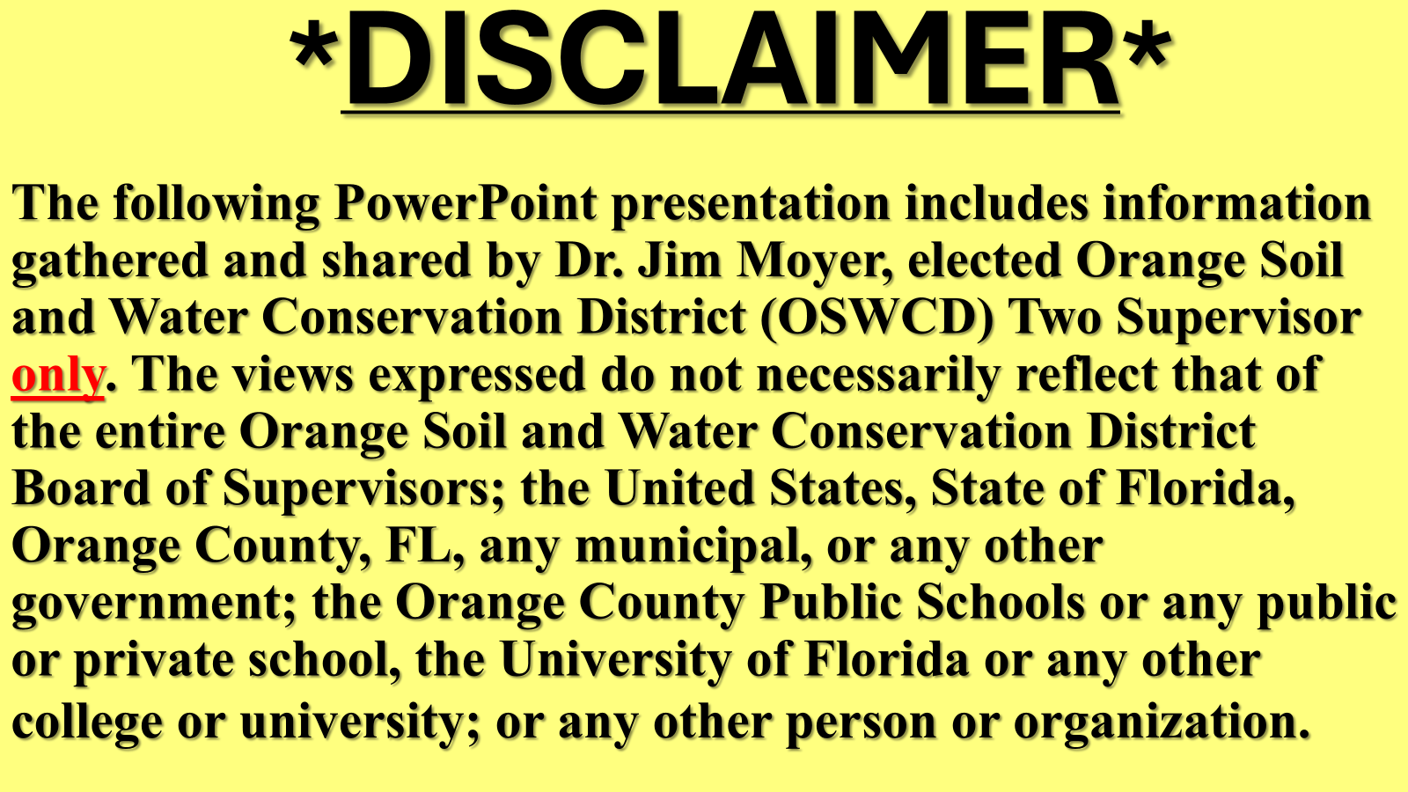
2026-06-30 Public Comment Exhibit 3 – Orange County Soil and Water Conservation District 2 Supervisor Jim Moyer

Slide 2
WELCOME TO THE “DAWN OF AN ERA OF GLOBAL WATER BANKRUPTCY”
(ACCORDING TO THE UNITED NATIONS)

Slide 3
MISSION (PURPOSE)
FL SOIL AND WATER CONSERVATION DISTRICTS like
Orange Soil and Water Conservation District (OSWCD)
The purpose of the soil and water conservation districts is to work in conjunction with federal, state, and local agencies in implementing land and water resource protection practices (F.S. 582.02(4).

Slide 4
WATER IS LIFE
AND A LIMITED RESOURCE
WATER, a finite global natural resource, sustains ALL life including plant, animal, fish, human, and SOIL. OSWCD must aid in protecting Orange County land and water resources, our job.

Slide 5
GLOBAL WATER BANKRUPTCY
“UN Headquarters, New York (20 January 2026) –
Amid CHRONIC GROUNDWATER DEPLETION,
WATER OVERALLOCATION,
LAND AND SOIL DEGRADATION, …, and
POLLUTION, all compounded by global heating, a UN report today declared the DAWN OF AN ERA OF GLOBAL WATER BANKRUPTCY, ….” (emphasis added) “Era of Global Water Bankruptcy” UN University

Slide 6
UN SCIENTIST EXAMINES
AI WATER USE
UN Scientist discusses limiting AI environmental impact in a livescience.com article noting “recent United Nations report”. This scientist stated “…by 2030, [AI could be] guzzling as much water as the 1.3 billion people in sub-Saharan Africa consume in one year to meet their domestic water needs.”

Slide 7
UN SCIENTIST EXAMINES
AI WATER USE (con’t)
UN Scientist discusses limiting AI environmental impact. The Director, United Nations University Institute for Water, Environment and Health states: “You have to decide if you want to continue using your water for agriculture or if you want to put it into data centers.” Kaveh Madani

Slide 8

KEY to LIFE is
WATER
==================================
KEY
D2 C3 Water CHALLENGE is

Slide 9
TO ALL YEAR AROUND
Change HABITS
Conserve WATER use
Clean WATER BODIES

Slide 10


BE SMART, DO YOUR PART

Slide 11


