Slide 1
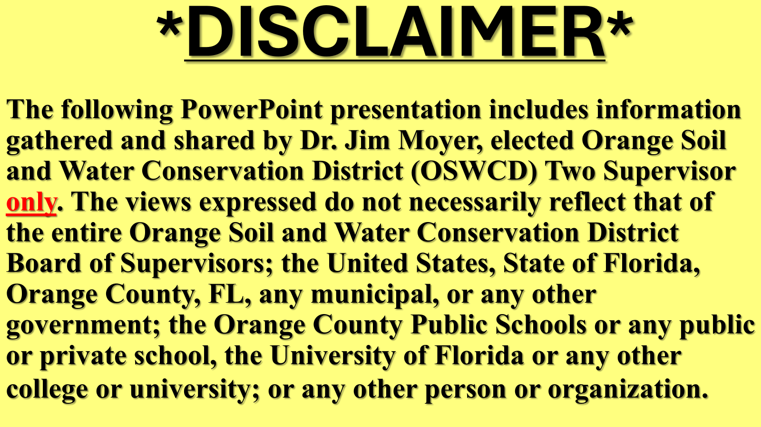
2026-06-02 Public Comment Exhibit 1 – Orange County Soil and Water Conservation District 2 Supervisor Jim Moyer

Slide 2
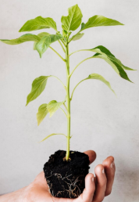
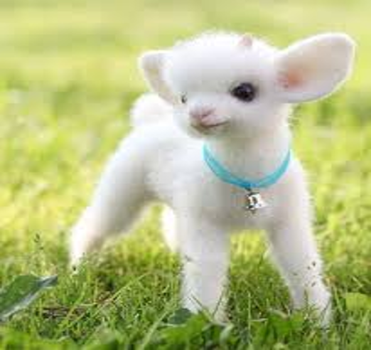
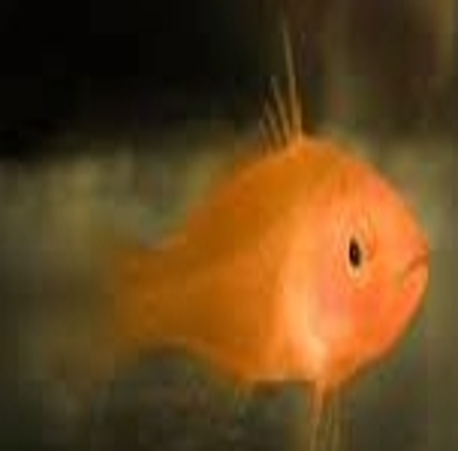

ESSENTIAL FOR LIFE
PLANT ANIMAL
FISH HUMAN
REQUIREMENTS
ALL THE SAME
AIR
WATER
FOOD

Slide 3
OSWCD
D2 C3
WATER CHALLENGE
Change HABITS
Conserve WATER use
Clean WATER BODIES

Slide 4
Change HABITS
HABITS
MATTER

Slide 5
Conserve WATER
FIX IT-leaks
FILL IT-washer
FIXTURES-new

Slide 6

YOUR REWARD

Slide 7
Clean WATER BODIES
PICK UP-litter
PICK UP-pet doo
PICK UP-leaves

Slide 8
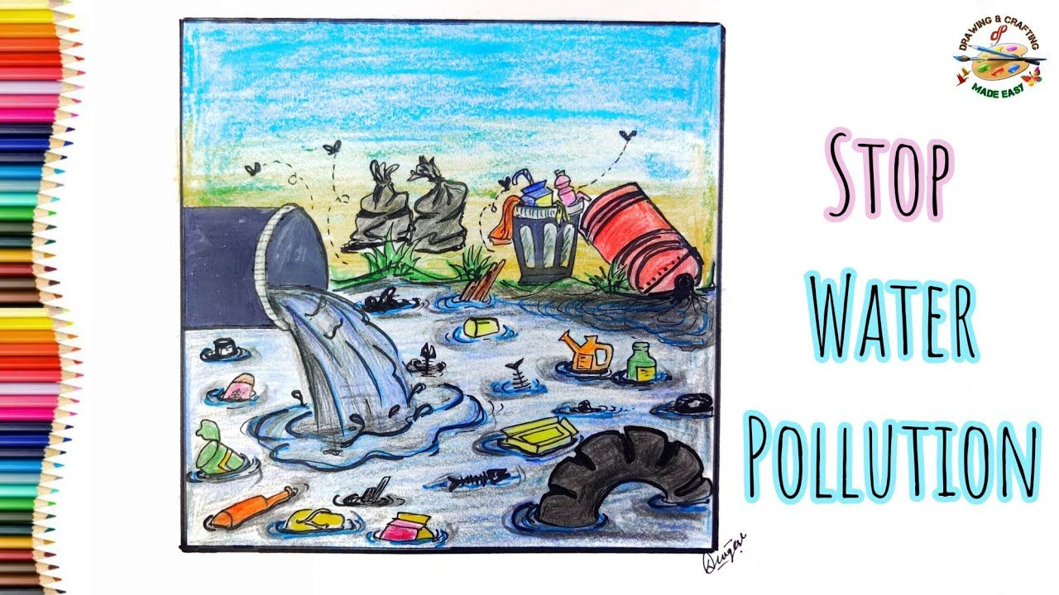
OUR REWARD, OUR FUTURE

Slide 9


BE SMART, DO YOUR PART

Slide 10


