Slide 1
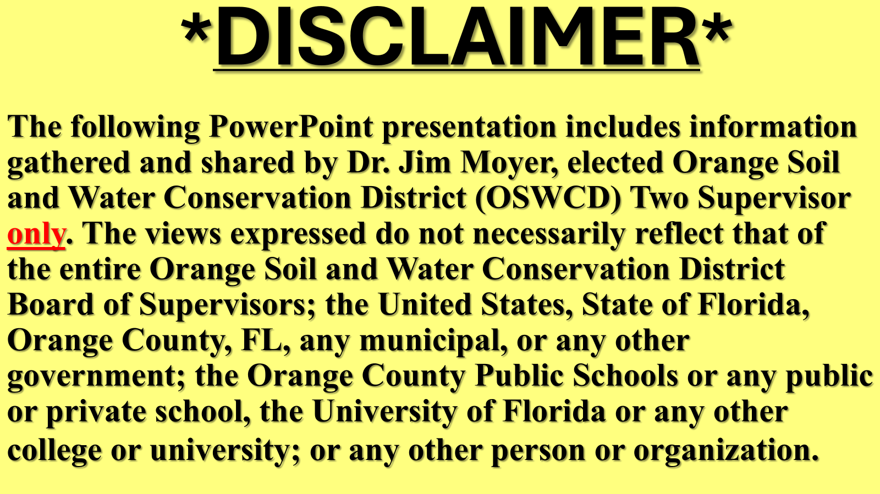
2026-05-05 Public Comment Exhibit 2 - Orange County Soil and Water Conservation District 2 Supervisor Jim Moyer

Slide 2
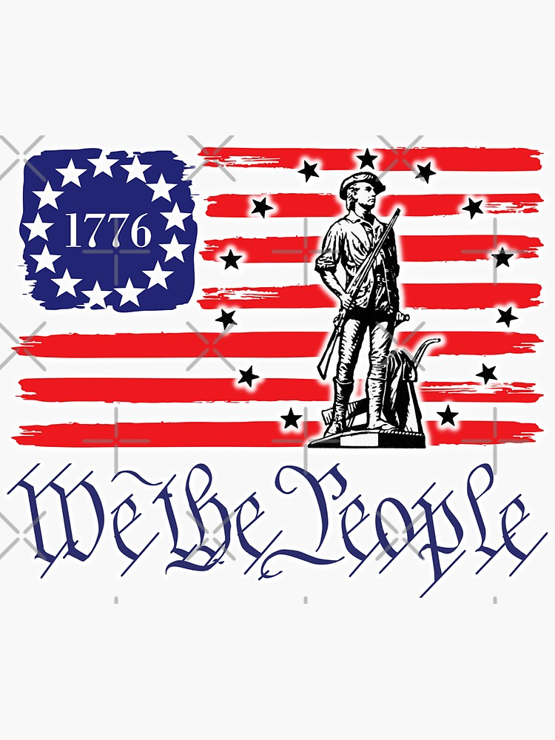
USA 250 Year Anniversary
July 4, 2026

Slide 3
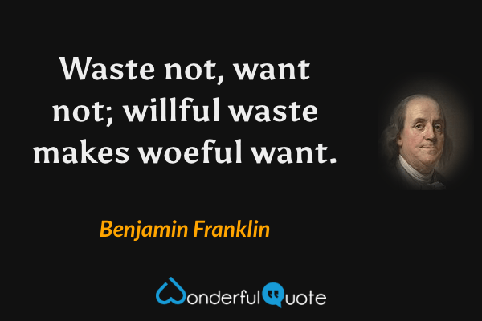
FRUGAL FOUNDING FATHER BEN FRANKLIN
QUOTE #1

Slide 4
IN HONOR OF BEN FRANKLIN
AND AMERICA’S 250TH ANNIVERSARY
ORANGE SOIL AND WATER CONSERVATION DISTRICT (OSWCD) TWO (2) IS KICKING OFF THE:
D2 C3
WATER CHALLENGE

Slide 5
D2 C3
WATER CHALLENGE – step one
OSWCD D2 C3
Change – create two new habits
Conserve – one new water conservation habit to do every day*
Clean – one new water quality improvement habit to do every day*

Slide 6
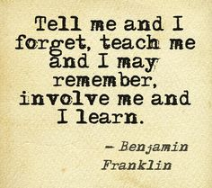
BEN FRANKLIN, THE SCHOLAR AND EDUCATOR
QUOTE #2

Slide 7
D2 C3
WATER CHALLENGE – step two
*Tell your family, friends, and neighbors about your new C3 initiatives
*Teach them how to take part in the OSWCD D2 C3 Water Challenge
*INVOLVE them and organizations in this D2 C3 Water Challenge

Slide 8
For D2 C3 WATER
CHALLENGE INFORMATION
*Such as personalized ideas that will work for both you and our limited water resources contact:
Dr. Jim Moyer, elected Orange Soil and Water Conservation District 2 Supervisor
Email: oswcd.d2c3waterchallenge@gmail.com or 754 367 4174, leave a voice message or text
Let us know how you are doing, how we can help!

Slide 9
DO YOU KNOW SIMPLE THINGS LIKE
*TURNING OFF WATER WHILE BRUSHING OUR TEETH AND WHILE SOAPING UP DURING SHOWERS EVERY DAY WILL CONSERVE OUR LIMITED WATER RESOURCES?
*GOING TO A CAR WASH (INSTEAD OF WASHING CARS IN THE DRIVEWAY); PROPERLY MAINTAINING OUR CARS (NO LEAKS ONTO OUR DRIVEWAYS); AND RECYCLING CLOTHES NOT BUYING NEW REDUCES WATER POLLUTION?

Slide 10


BE SMART, DO YOUR PART

Slide 11


